Slide 1
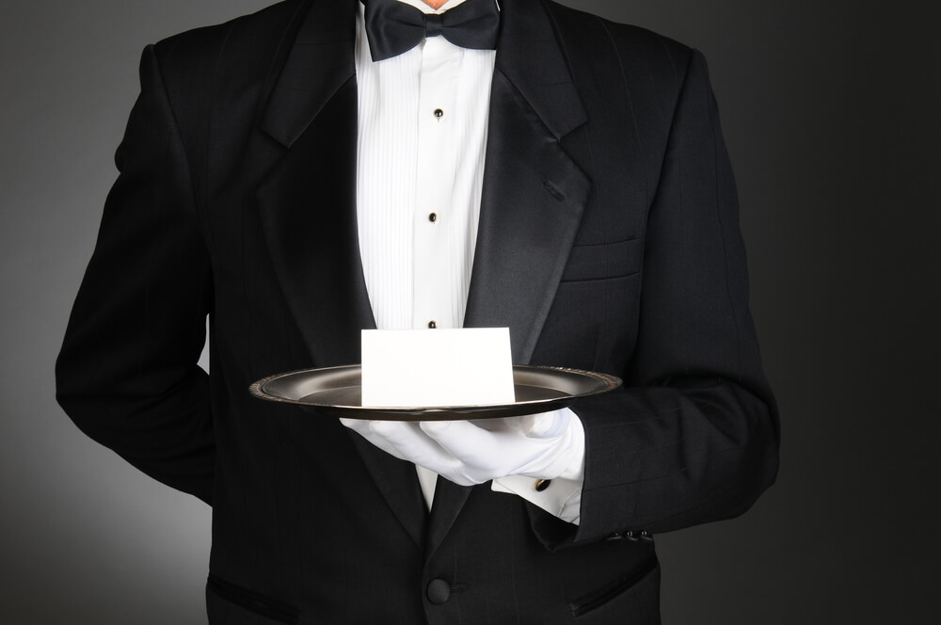
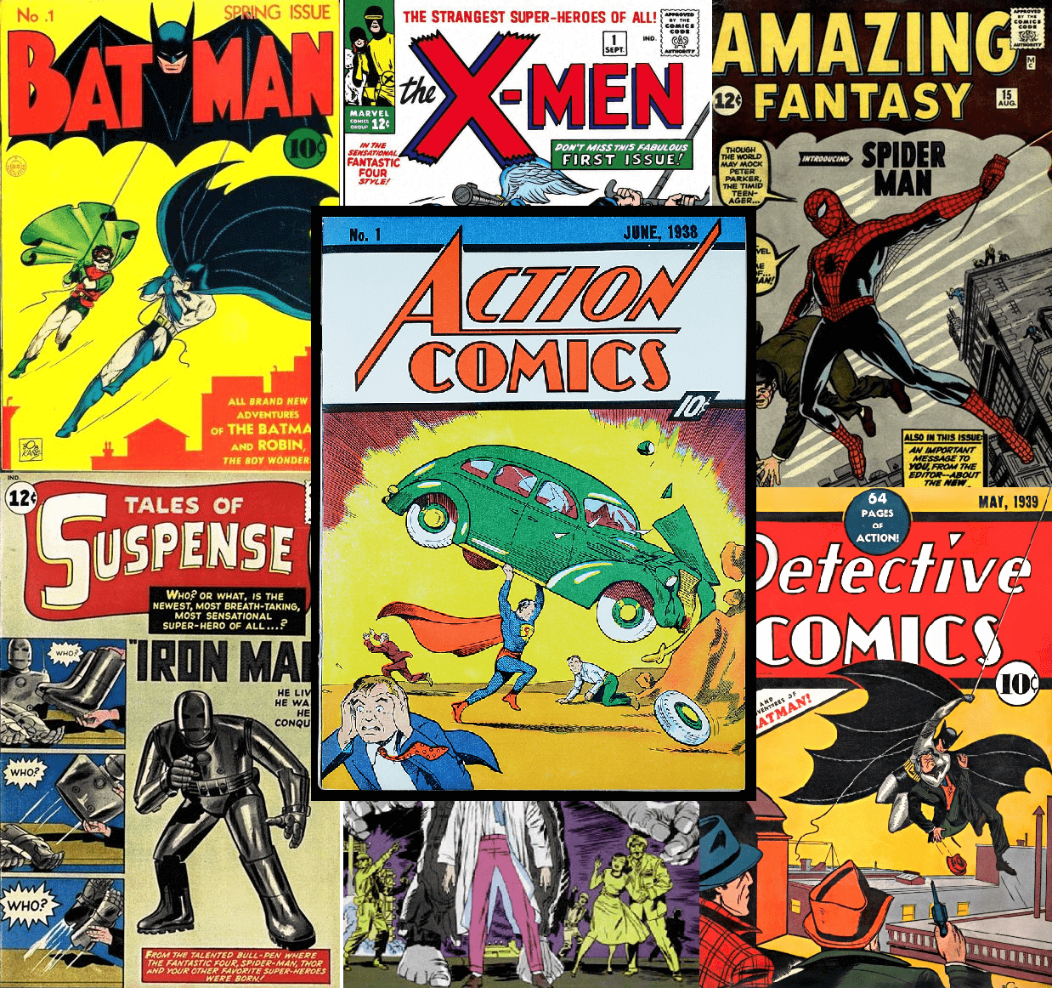
Comic Convention Concierge Application
A behind-the-scenes look at Team Austin’s site!
Notes:
Overall Concept: Team Austin’s overall concept was an application that provided convenience to comic book fans and anime enthusiasts as they visit their chosen conventions. This applications make use of the Marvel API to locate their favorite Marvel Creators, their top 5 creative projects and where the creators are located in the convention center. The Yelp and Google APIs are used to provide users with the best in surrounding restaurants, hotels and entertainment near the convention center. There is a trivia game for users to play as they wait in line to get autographs or for panel discussions. There is a sign up for users to receive a newsletter about future conventions and other comic news. Finally, users can download this application to their smart devices, laptops and even desktops.

Slide 2
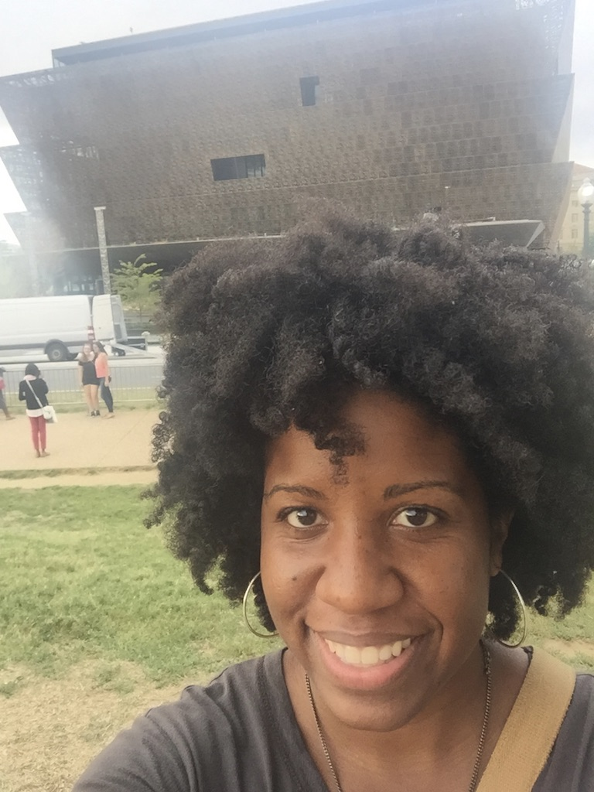
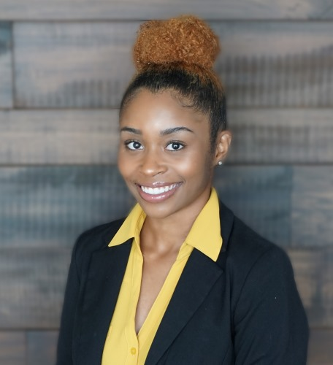
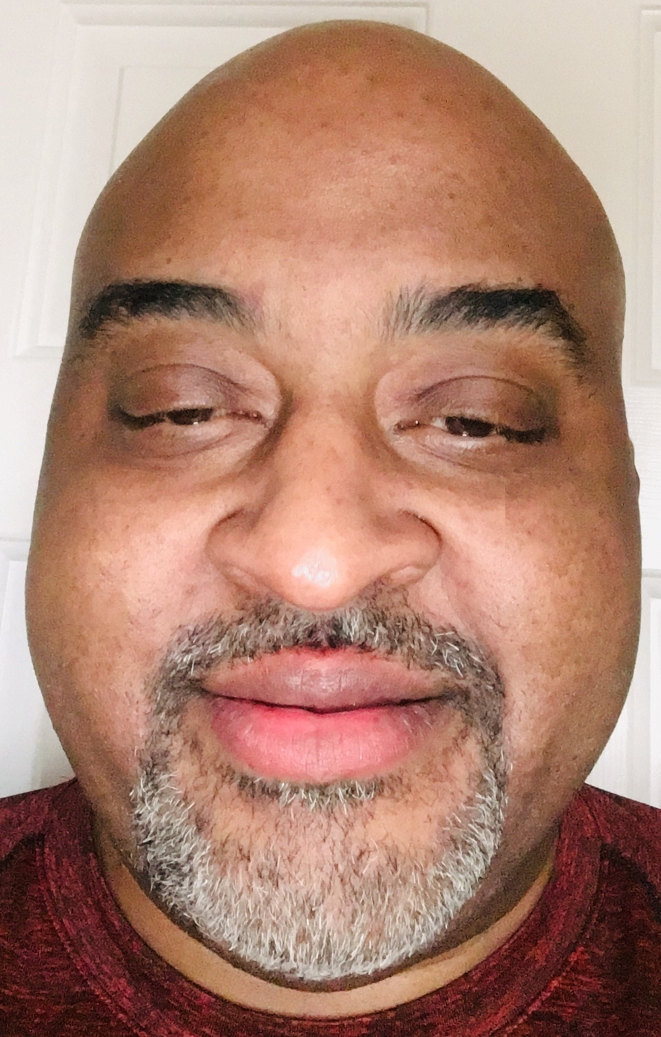
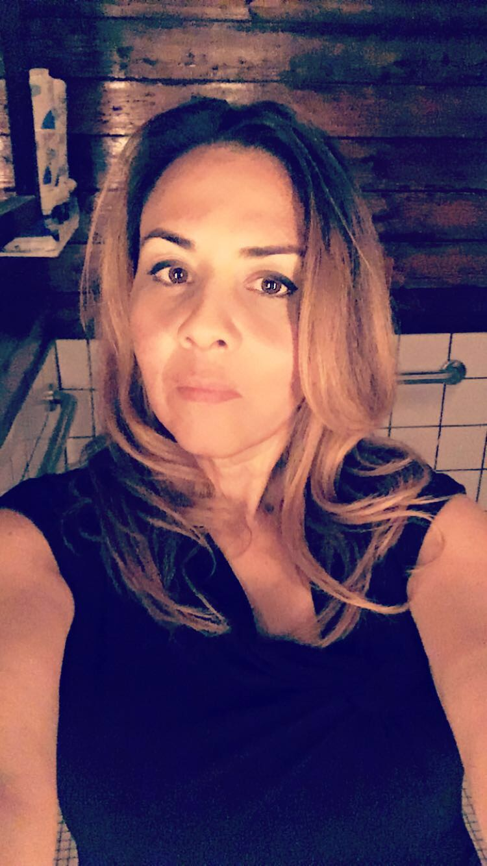






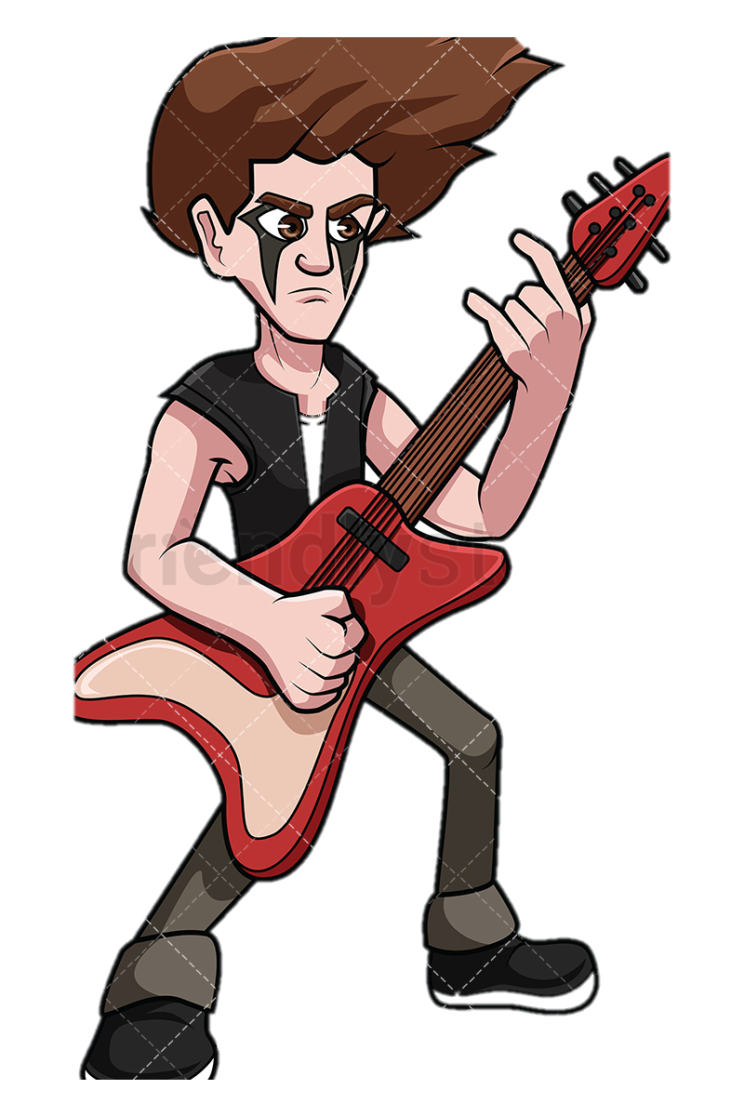




Cooking
Videos
Cooking
Comics
Comics
Video
Games
Comics
Travel
Minorities
Anime
Heavy Metal
Basketball
Comics
Environment
Cooking
Movies
Notes:
Motivation: After a brief discussion, when we were assigned our groups, all the members of Team Austin recognized that we all had an affinity for comic books in some way. So we then put our heads together and decided that the Comic Book Conventions and the people that do cosplay or just enjoy comic conventions were an untapped market, ripe for needing an application developed targeted at giving them a more entertaining experience while at the conventions!

Slide 3

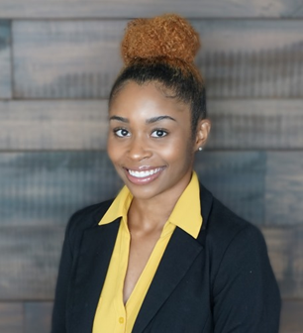


Adrienne:
Project Organizer
GitHub Manager
Javascript Coding
Janavia:
Yelp API coding
Google API coding
Javascript coding
Sara:
Graphic Design
CSS styling
User Experience advisor
Hugh:
Marvel API coding
Project ideas
Bootstrap coding
Notes:
Design Process: During the process of fleshing out the details of this project, we decided to play to our individual strengths. There was constant assistance between team members, on all parts of the coding effort, but task responsibility and accountability was established and strictly adhered to by all team members. Our final product is the result of an effort all of us, before you, can say was a shared enjoyment and expanding work effort on our part.

Slide 4









Developer API
Developer API
Cycle
Notes:
Technologies Used: To accomplish producing the site we are presenting required the following technologies:
Ajax – for doing callbacks to the various APIs with JSON results.
Bootstrap – for arrangement divs, images, and other html coded items.
jQuery – for providing more convenient element selection coding mechanisms.
jQuery cycle – for providing a simple image repository for animation.
Yelp API – for performing a callback for local restaurant, hotel and entertainment results.
Marvel API – for performing a callback of creators who would appear at the comic convention.
Google Map API – used in connection with the Yelp API to provide location data for the surrounding areas near the convention.
Javascript – for coding the interactive responses to user’s choices and options.
CSS – for styling the look and feel of the site itself.

Slide 5

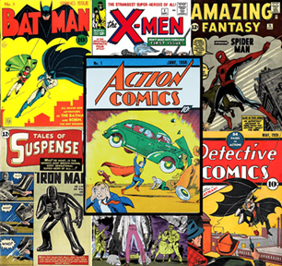
Comic Convention Concierge
Site Demonstration
Comic Convention Concierge
Site Demonstration
Notes:
At this point, we will pull up the site and show it off, with each of us ready to speak and answer questions about the parts we played in its creation.

